Slide 1

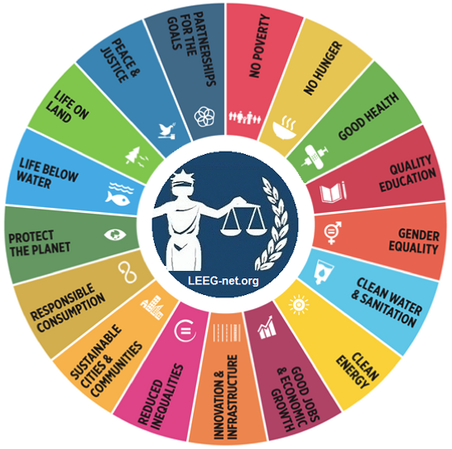
UNITAR HACKATHON 2024
ADDRESSING PERIOD POVERTY: A HACKATHON PROJECT
BY
CHINELO NWANKWO
KEEP ME HEALTHY-GIVE ME HOPE FOR TOMORROW
“END PERIOD POVERTY”

Slide 2

Image source: Times of India
EmpowerHer
Changing Stories One Girl at a Time

Slide 3

PERIOD POVERTY- A COMMUNITY HEALTH DILEMMA
Period poverty can be defined as the lack of access to safe and hygienic menstrual products during monthly periods.
It's important to note that period poverty is a complex issue influenced by cultural, economic, and social factors.

Slide 4

BACKGROUND:
This project will serve as a base rock for young girls, women, underserved communities, people with disabilities and individuals all over Nigeria , Africa and the world at large who are affected by period poverty in one way or another.
OBJECTIVES:
Create awareness and teach reproductive health in rural/urban areas
Provide sustainable and eco-friendly sanitary products for women
Integrate programs that runs via mentorship and train the trainer approach
To help women become inclusive and reduce the negative impact of period poverty

Slide 5

LET’S TALK NUMBERS
Globally, it is estimated that approximately 500 million women and girls lack adequate facilities for managing their menstrual hygiene needs. (Source: UNICEF and WHO)
According to a 2014 UNESCO report, In sub-Saharan Africa, it is estimated that 1 in 10 menstruating youth miss school during their menstrual cycle due to lack of access to menstrual products and resources. which equates to up to 20% of a school year. (Source: UNICEF)

Slide 6
37 million Nigerian women of menstruating age do not have access to sanitary pads due to financial constraints
One study on the social and health implications of this found that two-third of pad users received their pads from sexual partners.
Around 10% of 15-year-old girls surveyed, reporting engaging in sex for money to buy pads, a much higher rate than among older women.
In Kenya, 65% of women and girls are unable to afford sanitary pads.

Slide 7
In some countries, women and girls spend as much as 15% of their monthly earnings on their menstruation needs, according to a recent report by PlushCare, a virtual health platform providing primary care and mental health treatment.
It is estimated that 16.9 million menstruating women in the United States live in poverty, two-thirds of which are low-income and food-insecure women who cannot afford basic menstrual products such as pads, tampons, and other sanitary products.

Slide 8
IMPACT OF PERIOD POVERTY
Health challenges
School Absenteeism
Impact on Education
Economic Impact
Global Disparities
Social Awkwardness

Slide 9

SOCIAL IMPACT OF PERIOD POVERTY
Health and safety: lack of appropriate sanitary products leading to long/short term health challenges and complication
Education: Increase in school-girls dropout
Paid work: due to this problem even working women prioritize other amenities over sanitary products
Conflict and crime: sex work in exchange for cash for sanitary products leading to STI/STD
Family living: family prioritizing food and water over sanitary products for the girl child creating resentment
Gender: the girl child loses confidence in self and shies away from social activities
Human right: all women should have access to basic sanitary product to improve total well being
Minority groups and people with disability receive double blow especially those living on the poverty line
Stratification and classism: those who cannot afford products find themselves laughed at and shunned by others dealing a huge blow to self esteem

Slide 10

HEALTH RISKS AND BARRIERS
Period poverty has been linked to health issues such as;
Urinary tract infections
Increased risk of poor health outcomes
Spike in early pregnancy, HIV/AIDS, and STDs
Future infertility and birth complications;
Not having access to hand-washing facilities can lead to the spread of other infections, like Hepatitis B and thrush.
Depression Girls are led to believe they are unclean
Toxic shock syndrome
Death

Slide 11
BARRIERS
Barriers to menstrual products
Barrier to Education and sanitation
Religious, social, cultural, and economic factors
Girls with disabilities
Those living in conflict-affected areas or after natural disasters i

Slide 12


SOLUTIONS
PROPER EDUCATION/MENTORSHIP
CREATE ECO-FRIENDLY/SUSTAINABLE PRODUCT (REUSABLE SANITARY PAD)
MENSTRUAL CUPS
PROVISION OF SANITATION AND PROPER SANITIZATION FACILITY
PARTNERSHIP WITH NGO’S IN EMPOWERING WOMEN AND GIRLS
MENTORSHIP AND TRAIN-THE TRAINER WORKSHOPS FOR CONTINUITY

Slide 13

EDUCATION AND MENTORSHIP
Image source: World Bank Blogs

Slide 14

METHODOLOGY
This project will comprise of leveraging digital technology to create awareness
Empower youth and women with the requisite knowledge and skills needed to navigate and grow in digital world of health
TARGETED AUDIENCE
This will reach out to and encompass teenagers, young adults and women of all ages all around the world.

Slide 15
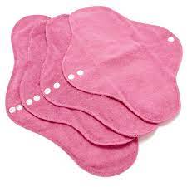
PRODUCT DESIGN/APPLICATION
The reusable sanitary pad is not a novel product, but for the aim of this Hackathon we will take into consideration its economic value, environmental impact, and social impacts, and most importantly, the positive effects they have on the day to day lives of women around Africa.
GOAL:
Provide three reusable pads per girl/woman
Provide menstrual cups
Educate them on proper use, care and hygiene
Repeat this exercise at least every quarter
Image Source: Center for family

Slide 16
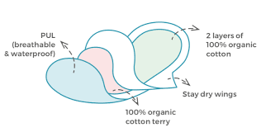
ECO-FRIENDLY/BIO-DEGRADABLE MATERIALS
Image source: Bamboolik

Slide 17

3D Printing of Menstrual Products:
Description: 3D printing technology can be used to create low-cost and environmentally friendly menstrual products, providing an alternative to traditional disposable products.
Benefits: Enables local production of menstrual products, reduces costs, and contributes to environmental sustainability.
Online Platforms for Donations:
Description: Web or mobile platforms that facilitate online donations for menstrual products. Users can contribute financially, and the funds are used to purchase and distribute products to those in need.
Benefits: Provides a convenient way for individuals to support initiatives addressing period poverty, allowing for widespread contributions.

Slide 18

REUSABLE ECO-FRIENDLY MENSTRUAL CUPS
Image source: PutAcupINit

Slide 19
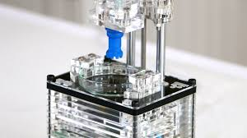
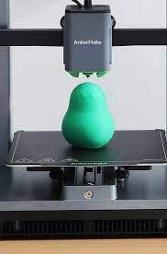
SILICONE 3D PRINTING OF MENSTRUAL CUPS
Image source: Kickstater
Image source: GadgetFow

Slide 20
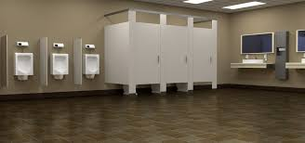
PERIOD-FRIENDLY PUBLIC WASHROOM

Slide 21
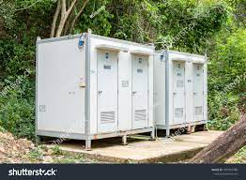
Period- Friendly Portable washroom

Slide 22

Smart Dispensers and Vending Machines:
Description: Automated dispensers or vending machines that offer free or low-cost menstrual products. These machines can be strategically placed in schools, public places, or community centers.
Benefits: Enhances accessibility to menstrual products, reduces stigma, and ensures availability in locations where people may face challenges in obtaining products.
Telemedicine and Chatbots for Support:
Description: Telemedicine platforms or chatbots that provide remote support and guidance on menstrual health. Users can access information, ask questions, and receive guidance on managing their menstrual hygiene.
Benefits: Overcomes barriers to seeking information, especially in regions with limited access to healthcare services, and empowers individuals to make informed decisions.

Slide 23

To address period poverty, we need to normalize conversations about periods to reduce shame and stigma. We can also talk to teens about how they purchase menstrual products to understand their needs and struggles.
Moreover, conducting more research can help us better understand the scope of the problem and advocate for change.
Building a coalition of advocates within the medical community and supporting policies that improve widespread access to menstrual products and cover the cost when distributed by school districts are also crucial steps towards ending period poverty.

Slide 24


COUNTRIES WITH LEAST AFFORDABLE SANITARY PRODUCTS
1.Algeria (14.8%) 2 Zambia (10.93%) 2 Nigeria (10.93%) 4.Ghana (9.39%) 5.Zimbabwe (9.27%) 6.Kyrgyzstan (9.05%) 7.Honduras (8.54%) 8.Jordan (8.38%) 9.Laos (8.33%) 10.Cambodia (7.74%)

Slide 25

LET’S DO MORE FOR ALL
THANK YOU

Slide 26
SOURCES
National Institutes of Health (.gov) https://www.ncbi.nlm.nih.gov › articles › PMC10372806
https://www.ncbi.nlm.nih.gov/pmc/articles/PMC4624246/
https://menstrualhygieneday.org/wp-content/uploads/2016/04/FSG-Menstrual-Health-Landscape_Kenya.pdf
https://plushcare.com/blog/cost-of-your-period/
Note: (Disclaimer) The above slide presentation is a compilation of information from various online sources, and while I curated and structured the content, intellectual property rights belong to the original authors and entities.

